Slide 1
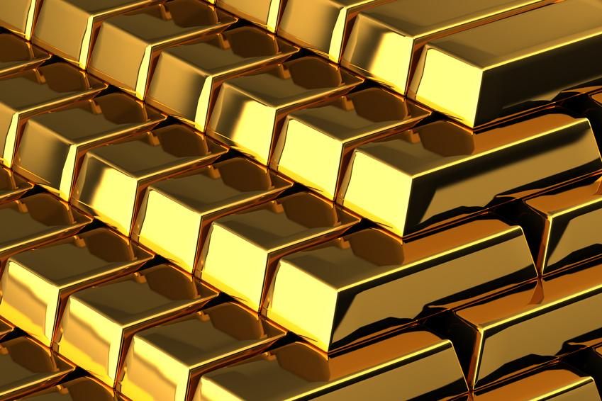
Deep-level gold mining on the Witwatersrand
Grade 8

Slide 2
Why gold is valuable
Mined for centuries
Rare metal - can’t rust / corrode
malleable metal - can be molded
never loses its shine
conducts heat and electricity
artwork & jewellery

Slide 3
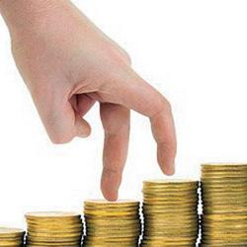
Symbol of wealth
and power

Slide 4
gold in witwatersrand
used by Africans for centuries before
only mined the pockets close to earth
it ran out - thought it was exhausted
1886 - new gold reef on Langlaagte
Prospectors came from all over to find gold
It changed South Africa forever...

Slide 5
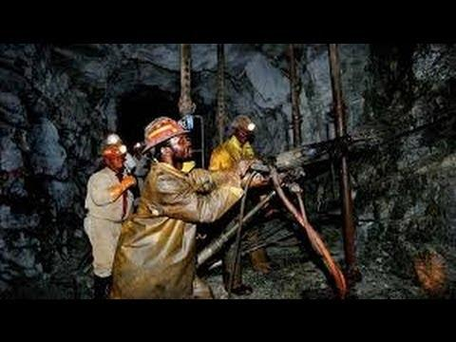
gold in witwatersrand

Slide 6
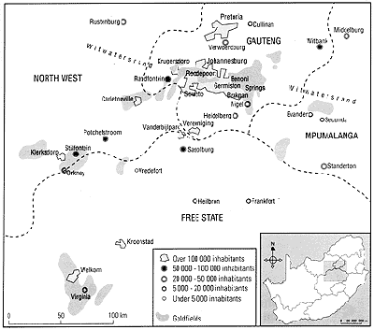
gold in witwatersrand

Slide 7
how gold is mined
discovered in ancient rocks ( 2 000 mil)
not concentrated
need to excavate tons of rock to produce small amounts of gold
deep-level mining needed new technology

Slide 8
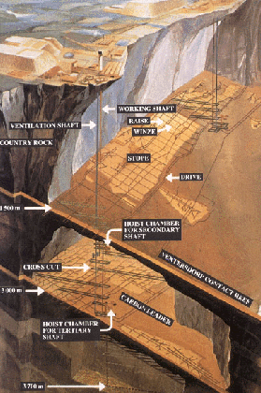
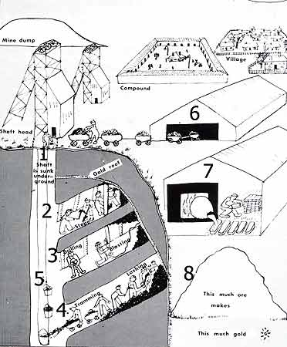
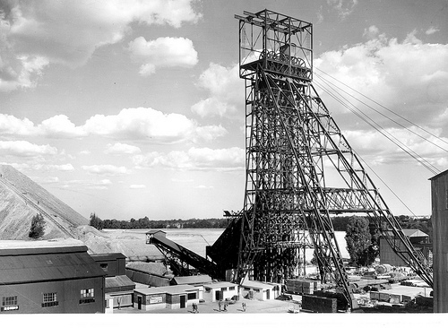
how gold is mined

